Slide 1
Amazon RDS for PostgreSQL – Monitoring Performance
Tools for Optimizing Database Performance

Slide 2
Agenda
Using CloudWatch with RDS PostgreSQL
CloudWatch Metrics Examples
Enhanced Monitoring
Performance Insights
Database Load
Counters
CPU Bottleneck
Wait Bottleneck

Slide 3
Using CloudWatch with RDS PostgreSQL
Publishing your database logs (Postgresql.log and Upgrade.log) to Amazon CloudWatch Logs is a best practice.
Ensures logs are preserved in highly durable storage.
Perform real-time analysis of log data
Supported for Postgres version 9.6.6+ and 10.4+
Enable Query Logging
log_min_duration_statement – Limit in milliseconds for a statement to be logged
log_statement – Determines which statements are logged [none, all, ddl, dml]
Note: Too much logging will degrade performance in production systems
Query information is included in Postgres.log file
Enable in the Console or the AWS CLI
rds modify-db-instance \
--db-instance-identifier rds-pg-lab \
--cloudwatch-logs-export-configuration '{"EnableLogTypes":["postgresql", "upgrade"]}'

Slide 4
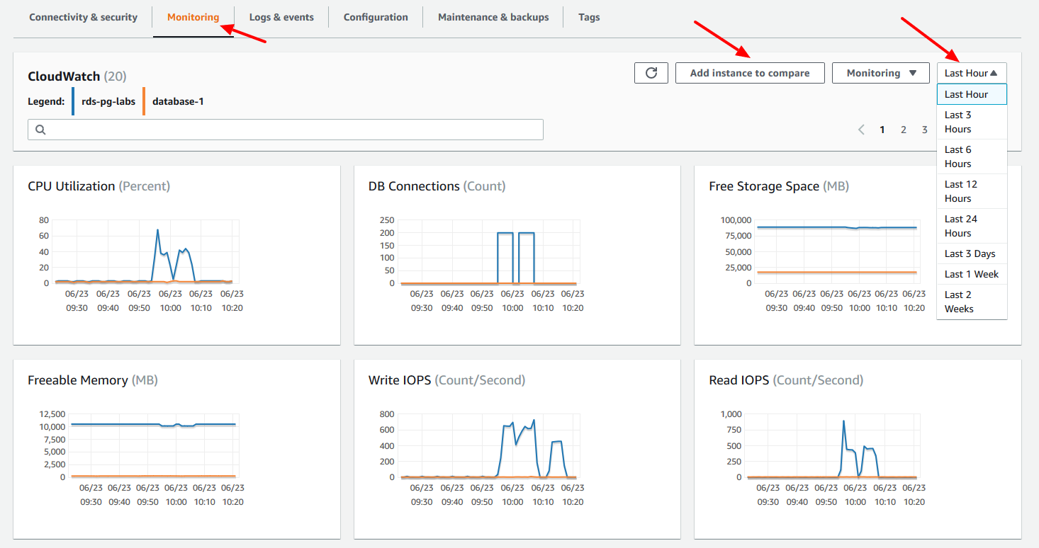
CloudWatch Metrics
CloudWatch also gathers metrics on the host underlying the RDS database. You can view these metrics in the RDS console under the monitoring tab.
CloudWatch Metrics:
CPU Utilization
DB Connections
Free Storage
Free Memory
Write IPOS
Read IOPS
Filter last hour to 2 weeks
Compare RDS instances

Slide 5
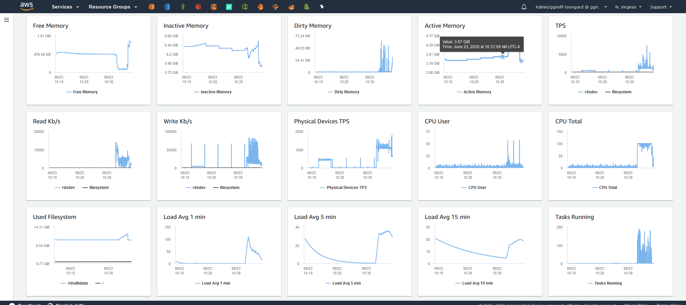
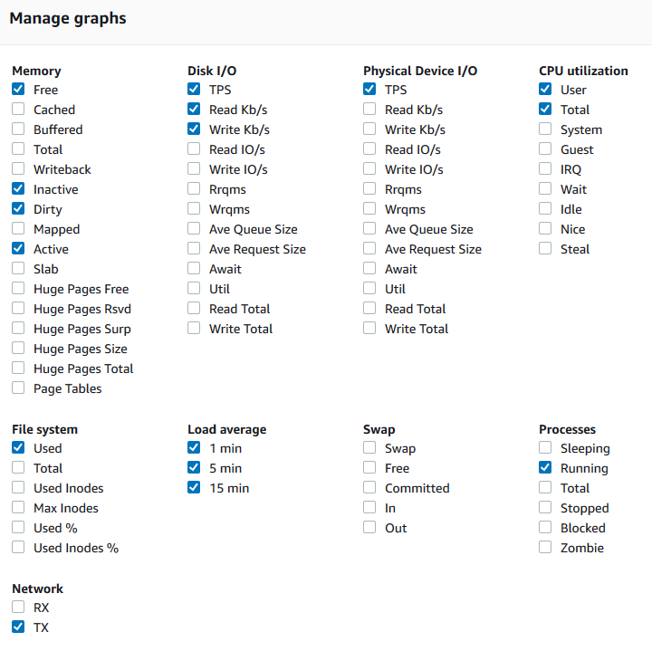
Enhanced Monitoring
Released on 2016, Enhanced Monitoring gathers finer grained OS metrics from an agent installed on the RDS host.
By default metrics are stored for 30 days. Governed by RDSOSMetrics log group in CloudWatch
Incurs additional CloudWatch costs based on granularity (from 1 to 60 seconds).

Slide 6
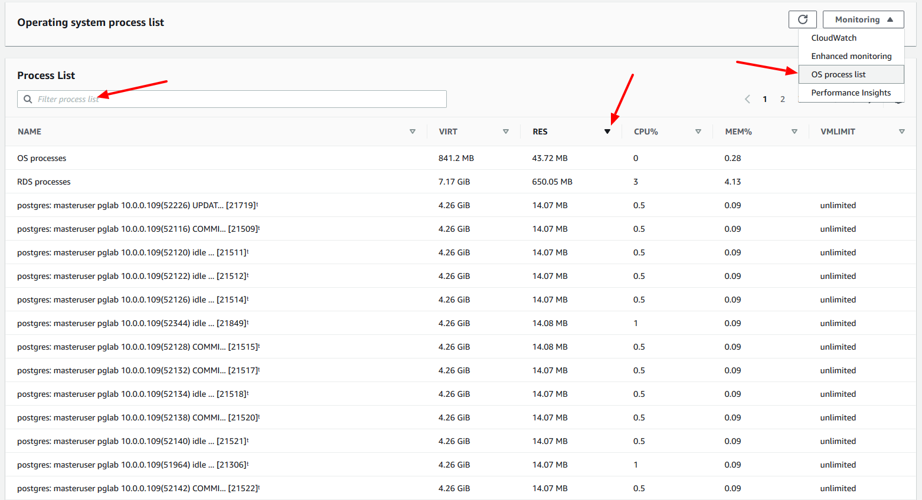
Monitoring – OS Process List
Enhanced Monitoring also includes the Process list, reachable from the monitoring dropdown. Sort the list by metric (e.g. CPU), filter for a particular user or database.
Process Groups
RDS Child processes
RDS Processes
OS Processes
Items Listed
VIRT – Virutal size of process
RES – Physical memory used
CPU% - Total CPU bandwidth
MEM – Total memory used

Slide 7
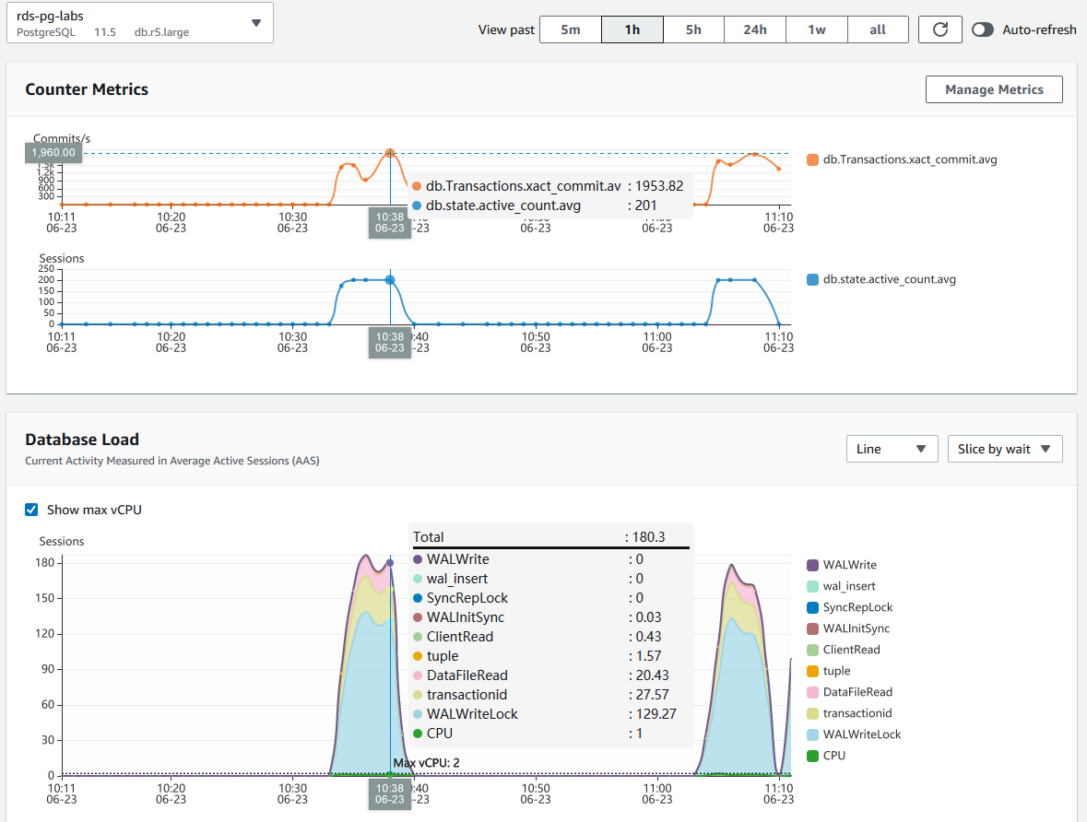
Performance Insights
Amazon RDS Performance Insights monitors your Database Load
Supported for PostgreSQL versions 10,11, and12
On by default in console create wizards
Expands on other RDS monitoring to illustrate database performance
Filter load by Waits, SQL Statements, Hosts, or Users
Change chart from the granular level of from 5 minutes to 1+ weeks

Slide 8
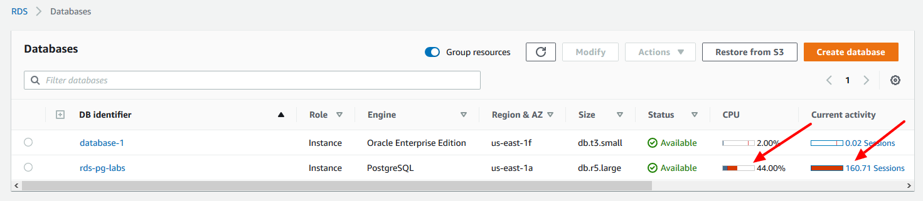
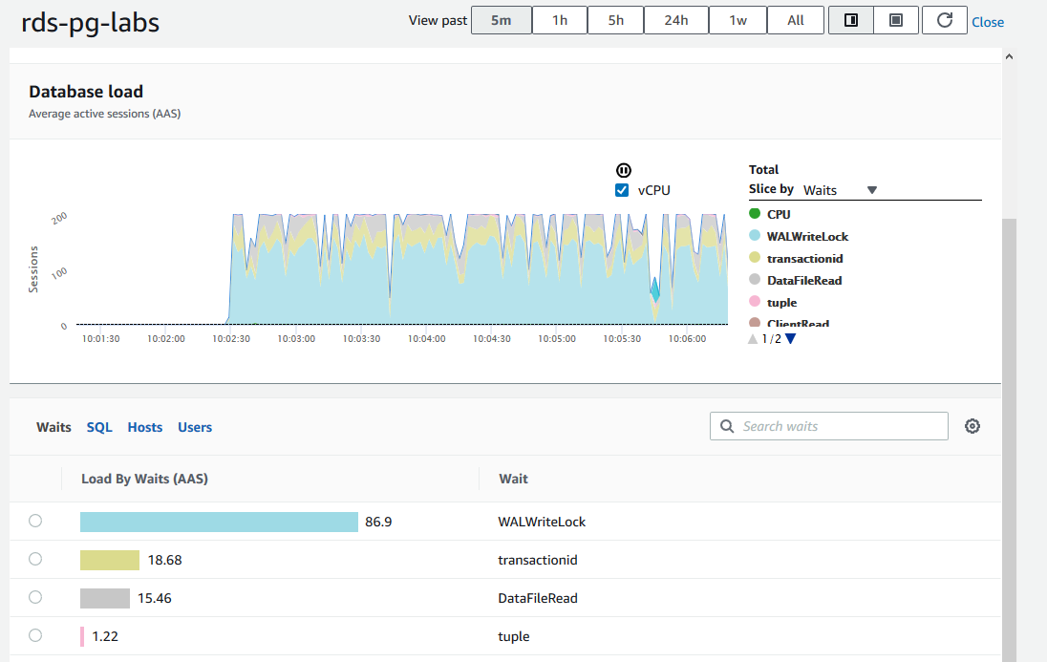
Performance Insights – Quick View & Access
In the RDS console there are two bar graphs (CPU & Sessions)
These give a quick view of overall state of your RDS instance.
Visible in the list of databases and details page
Clicking on the link for Sessions brings you to Performance Insights
Notes:
So here's the dashboard. We'll go into this in more detail as presentation goes on.
But basically, it's divided into two parts. On top we see the load on the database over time. And the idea is to make it really visually impactful, so that we can see the problems, immediately
what we see above is there's two spikes to green spike and I see this red spike. We'll go into this more detail. Green is about users running on CPU and reds, in this case locking
And then below that we have the top sequel, where's this load coming from. So we're like to CPU that first SQL statements, the one that's demanding all the CPU. In this case

Slide 9

What is “Database Load”?
All engines have a connections list showing
Active
Idle
We sample every second
For each active session, collect
SQL
State: CPU, I/O, lock, commit log wait, and more
Host
User
Expose as “average active sessions” (AAS)
Notes:
What is this thing talking about database load
All these database engines have a structure that tells us who's connected to the database, what are the connections to the database.
And for each of those connections it'll tell us which ones are active and which ones are idle. And what we do in performance insights as we look at that structure once a second.
Now that might sound like a lot of work, but remember, we're just reading from memory it's super lightweight and the test I've done it so my test is less than 1% of what we CPU.
And what we do is we look at the structure we ignore the idle connections we collect the data from the active connections.
So the connection is active we get. What's the equals user running, who is the user, what state are they all on CPU, are they waiting for some resource like IO or lock or buffer access.
What host is sequel being sent from like application server so I can see the load by application servers and who's the user running the sequel, and then expose this as a metric called average active sessions, which is really a measurement of the concurrency of load on database, how many users are concurrently active in the database, and we call this as our average active sessions. This is a measurement of concurrency on the db. We call it as AAS

Slide 10
Performance Insights –Sampling Sampling every second
Time
User 1
User 2
User 3
Fast query run rarely
Query run often
Slow query
Notes:
So here's a visualization of what we're doing. So time's running from left to right.
The vertical black lines are every second we collect data we wake up to collect the data.
The three horizontal lines are three users. And then the blue rectangles are active SQL and the database.
So, what are you an active user sends in a query, it takes a certain amount of time for the database to process that query and then finish it. That's the activity time.
And now I have three different types of queries in this slide, the bottom queries is a long running queries . It did not run much. it's run twice here, but multi seconds, and anything that's over a second will always capture. above about that as a shorter query sub second query that's run fairly often.
So we're going to make this sub second, so we're going to miss it some of the time, but a lot of the time we'll catch it, so it'll show up in our data.
Now the top query is a fast query that's not run very often, odds are we'll miss it completely. That might sound unnerving. But first of all that query is fast. It's already optimized. And it's not run very often it's not putting much load on my database.
So when I'm looking at database performance, it doesn't matter. One of the fringe benefits of sampling is it filters out all that noise and helps us concentrate on the big problems.

Slide 11
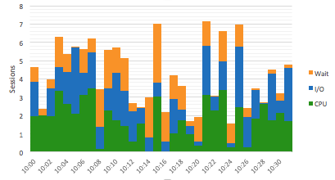
Performance Insights –Max vCPU chart
AAS compared to Max CPU
Max vCPU

Slide 12
Performance Insights - Yardstick
AAS < 1
Database is not blocked
AAS ~= 0
Database basically idle. Problems are in the APP not DB
AAS < # of CPUs
CPU available
Are any single sessions 100% active?
AAS > # of CPUs
Could have performance problems
AAS >> # of CPUS
There is a bottleneck

Slide 13
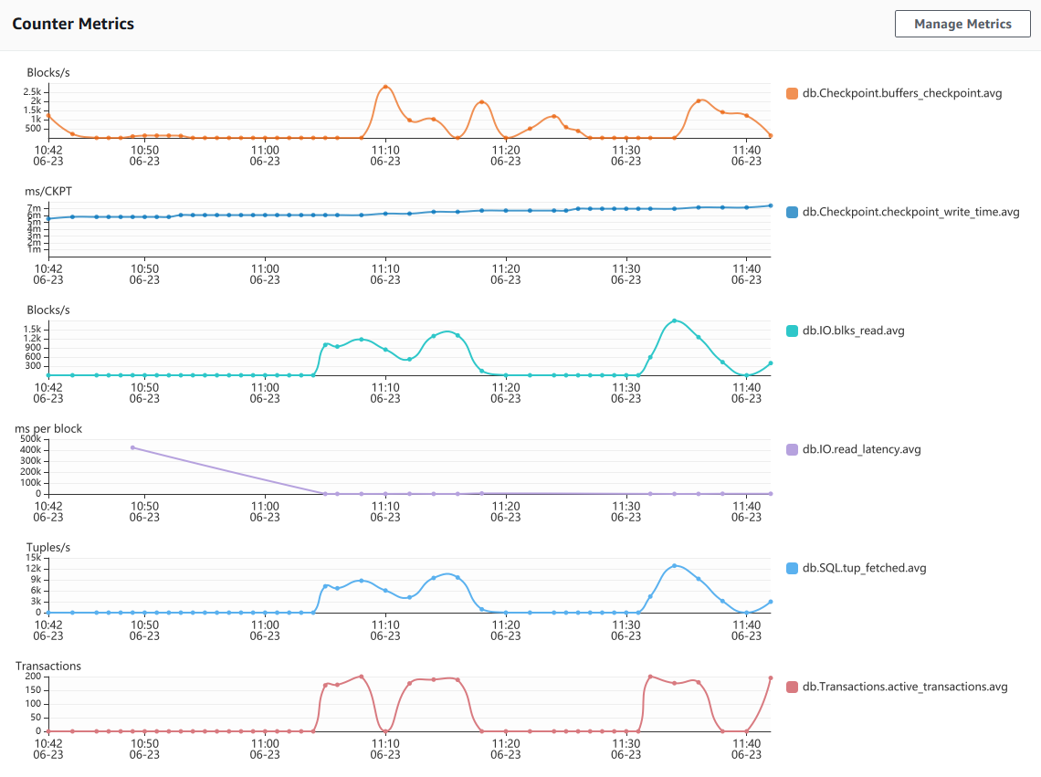
Performance Insights - Counters
Customize the Performance Insights Dashboard with up to 10 additional graphs
PostgreSQL Counter Metrics
blks_hit
buffers_alloc
buffers_checkpoint
checkpoint_sync_time
checkpoint_write_time
checkpoints_req
checkpoints_timed
maxwritten_clean
deadlocks
blk_read_time
blks_read
buffers_backend
buffers_backend_fsync
buffers_clean
tup_deleted
tup_fetched
tup_inserted
tup_returned
tup_updated
temp_bytes
temp_files
active_transactions
blocked_transactions
max_used_xact_ids
xact_commit
xact_rollback
numbackends
archived_count
archive_failed_count

Slide 14
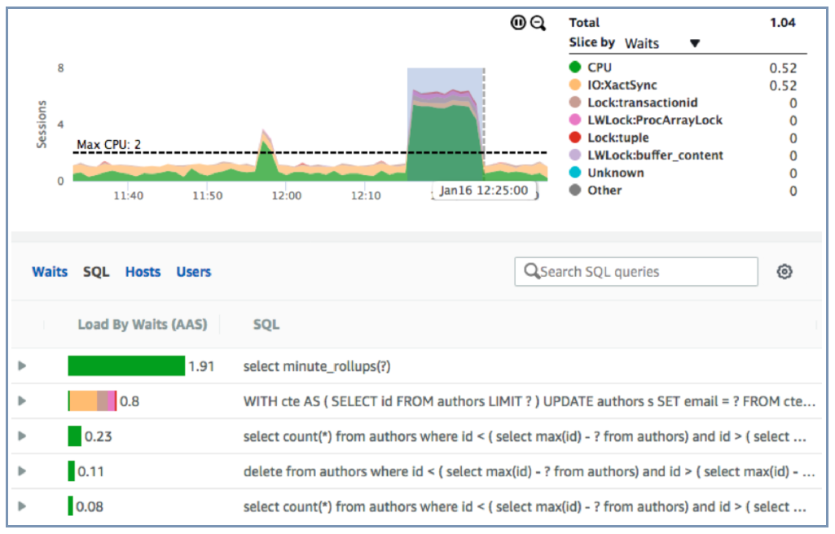
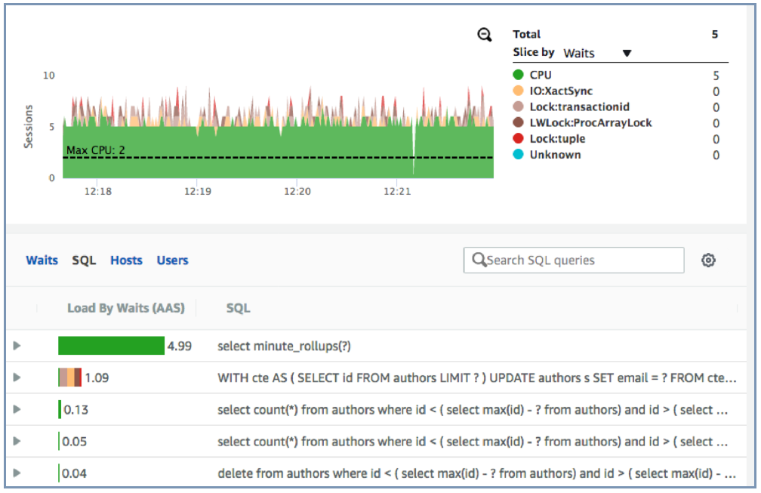
Performance Insights Example: CPU Bottleneck
Zoom in by clicking and dragging along timeline
Identify problem statement

Slide 15
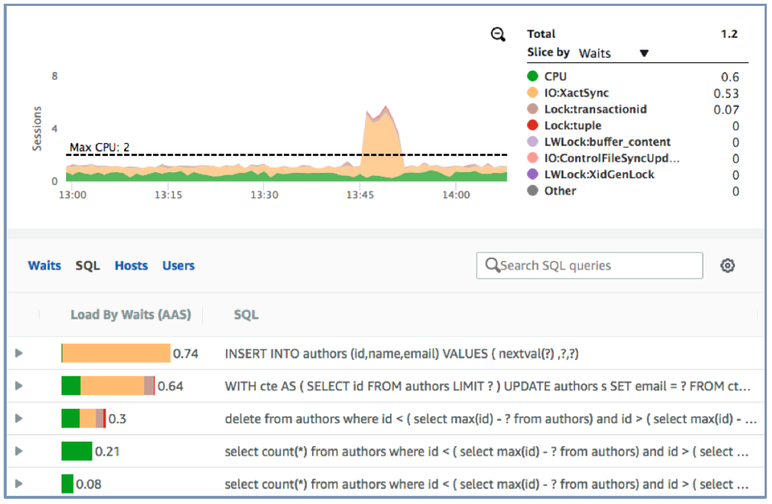
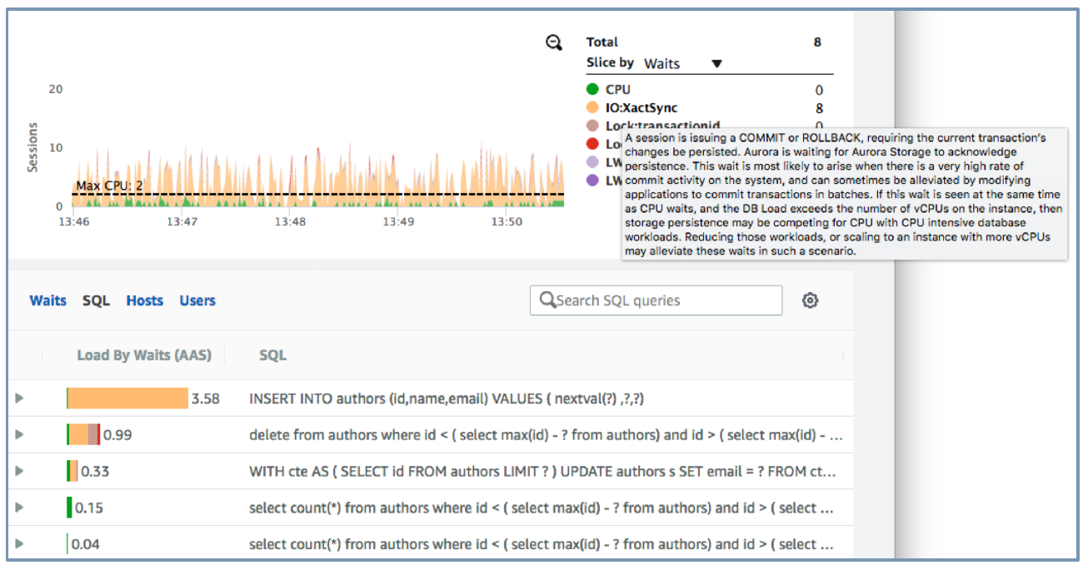
Performance Insights Example: Wait Bottleneck
Get contextual help for wait events
Identify problem statement

Slide 16
LAB

